Slide 1
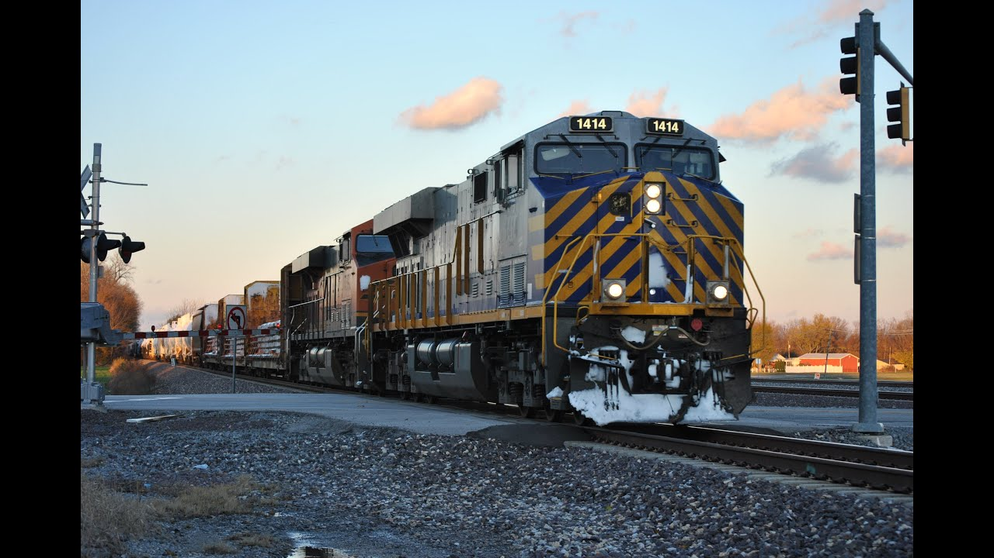
Railway Track
Crack Detection
System
Vasudev Jayachandran – 61
Aiswarya R - 65

Slide 2
PROBLEM STATEMENT
Unlike developed countries, Indian Railways do not have specific track for each type of train (goods/ passenger).
Due to weight and load difference, the track is more prone to fracture.
Passenger overcrowding (more than the capacity of the coach)
High temperature difference between day and night in northern India cause unequal expansion and contraction of tracks.

Slide 3
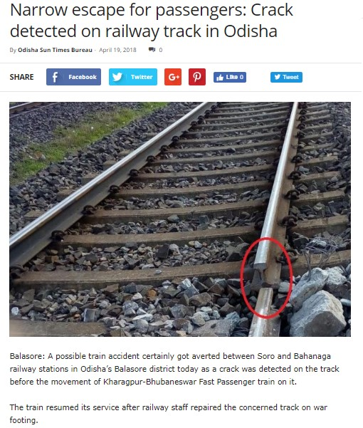
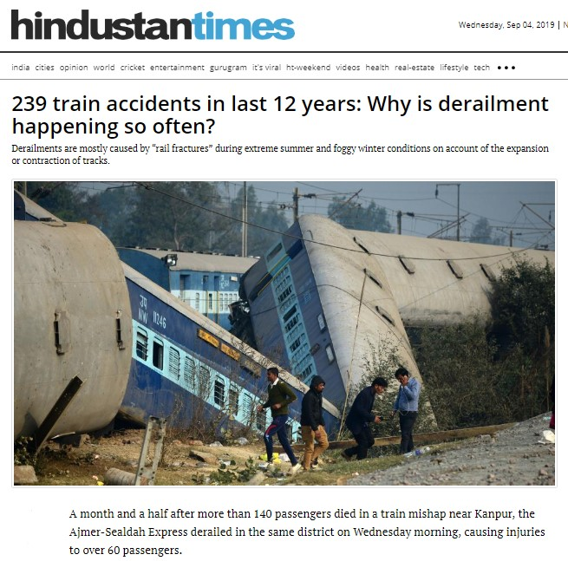

Slide 4
EXISTING SYSTEM
Currently, cracks can only be found if someone notices a crack on the rail and reports it to the authorities.
India have about 121,407km of railway tracks
There doesn’t exist any consistent/efficient technology to check for cracks.
Regular checking of railway tracks manually is impossible.
Almost 25 million daily users so, in case of an accident, casuality
will be high

Slide 5
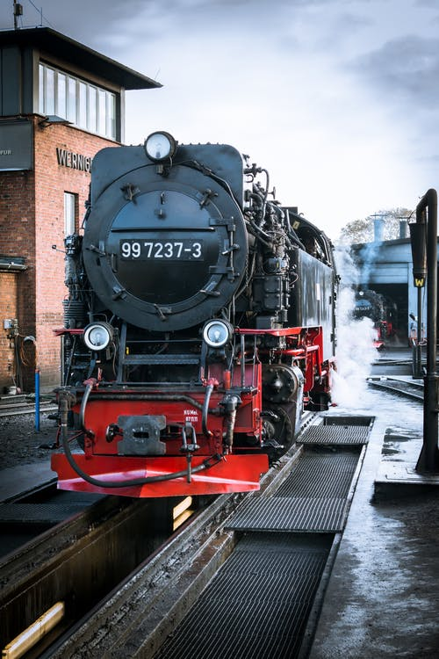
Proposed System
Automated Crack Detector
A vehicle running on tracks equipped with sensors to detect cracks on rails.
On detection, it is immediately reported to authorities along with location coordinates.

Slide 6

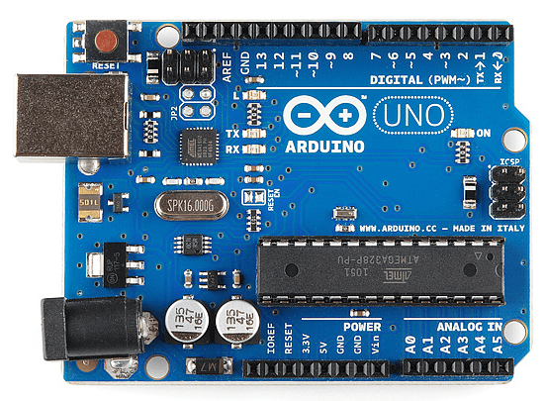
ADVANTAGES
Reliable and foolproof
Usable 24/7 as it uses ultrasonic sensors
Can be used on the normal railway tracks itself and tracks doesn’t need any modifications
Model uses Arduino board along with ultrasonic sensors so, it is
cost effective.

Slide 7

THANK YOU

